Slide 1
FIFA WORLD CUP
CS675 Introduction to Data Science Midterm Project
Ibrahim Mohammed Hamed

Slide 2
Objective
The objective of this project is to apply my data science skills in a real-world scenario by conducting EDA and creating insightful visualizations using Python libraries. The project will also focus on enhancing communication skills through the creation and presentation of a detailed project report.
The dataset I chose is ‘Fifa World Cup’ where we will dig deep and perform Exploratory Data Analysis.

Slide 3
Dataset Information
Data Preprocessing
Steps Taken to Cleanse and Prepare the Dataset
Handling Missing Values, and Imputations
Exploratory Data Analysis
Summary Statistics: Mean, Median, Mode, etc.
Visualizations: Histograms, Box Plots, Scatter Plots, Correlation matrix
Performance Analysis
Correlation Matrix: Insights into Performance Metrics
Comparison of Home and Away Team Goals
Analysis of Attendance Trends Across Matches
Stage-wise Analysis
Distribution of Matches Across Different Stages
Comparison of Performance Metrics Across Stages
Conclusion

Slide 4
Top Three Contributors
Home Team Goals
Team Goals
Attendance

Slide 5
Home Team Goals:
The mean number of goals scored by the home team per match is approximately 1.81, with a standard deviation of 0.69.
The minimum number of goals scored by the home team in a match is 0, while the maximum is 10.
The distribution of home team goals appears to be centered around the mean, with some variability observed.
Away Team Goals:
The mean number of goals scored by the away team per match is approximately 1.02, with a standard deviation of 0.47.
The minimum number of goals scored by the away team in a match is 0, while the maximum is 7.
The distribution of away team goals also appears to be centered around the mean, with relatively less variability compared to home team goals.
Attendance:
The mean attendance per match is approximately 45,164, with a standard deviation of 10,121.
The minimum attendance recorded for a match is 2,000, while the maximum is 173,850.
The distribution of attendance values exhibits some variability, with a notable range of values observed.

Slide 6
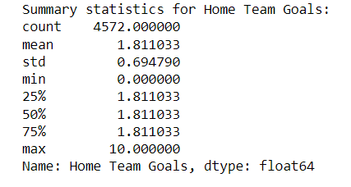
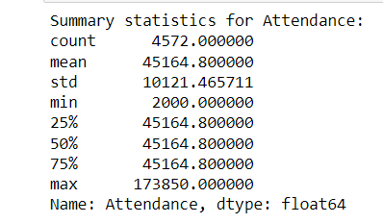
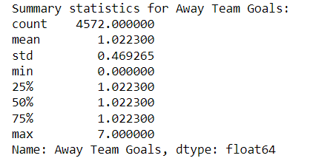
These statistics serve as valuable indicators of the key contributors/influencers in the dataset, highlighting the importance of goals scored by both home and away teams, as well as the level of audience turnout for matches.

Slide 7
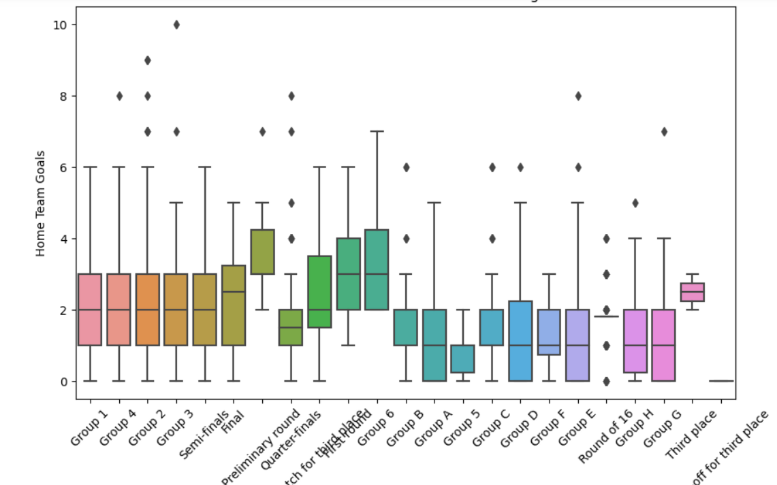
How does the home team's performance (measured by the number of goals scored) vary across different stages of the matches?
From the box plot of 'Home Team Goals' by 'Stage', we observe that the median number of goals scored by the home team varies across different stages of the matches. For instance, the median number of goals tends to be higher in the group stage compared to the knockout stages.
This suggests that the level of competition and the teams' strategies might influence the home team's performance in different stages of the matches.
Deeper Analysis:
We can further investigate whether there is a correlation between the home team's performance and the stage of the match by calculating correlation coefficients.
Additionally, we can analyze specific matches where the home team significantly outperformed or underperformed relative to their average performance in each stage.

Slide 8
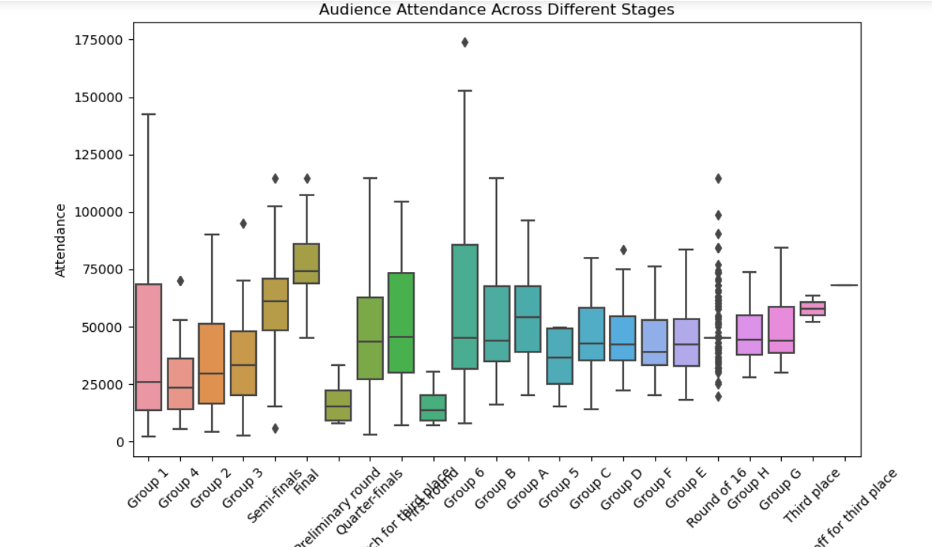
Is there a relationship between the attendance and the importance of the match stage?
From the box plot of 'Attendance' by 'Stage', we observe variations in attendance across different stages of the matches. Generally, matches in the knockout stages tend to have higher attendance compared to those in the group stage.
This suggests that the importance of the match stage, such as knockout matches determining the progression in the tournament, influences the audience turnout.
Deeper Analysis:
We can delve deeper into the factors contributing to higher attendance in certain stages, such as analyzing matches involving popular teams or matches held in specific stadiums/cities.
Additionally, we can explore whether there is a significant difference in attendance between matches played in different cities or stadiums and how factors like venue capacity might affect attendance.

Slide 9
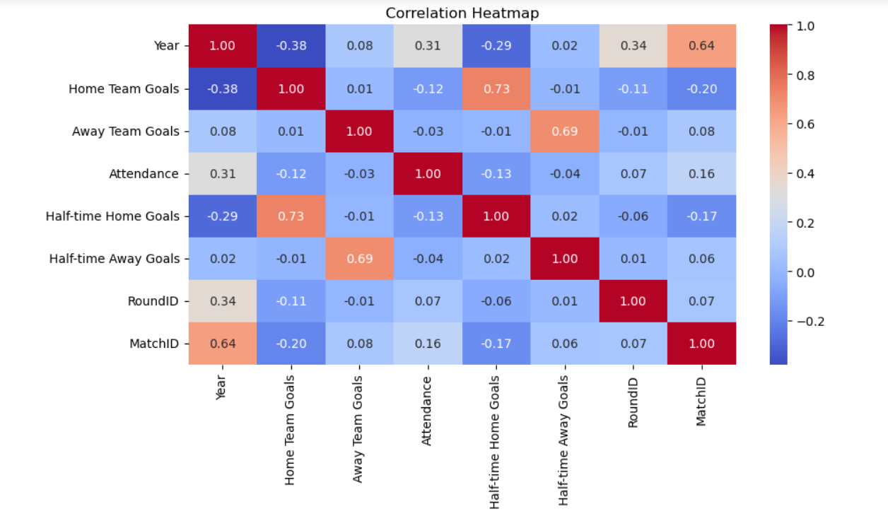
Correlation Matrix
Home Team Goals and Away Team Goals:
There is a very weak positive correlation (0.02) between the number of goals scored by the home team and the number of goals scored by the away team. This suggests that there is almost no linear relationship between these two variables. Teams scoring more goals at home are not necessarily correlated with teams scoring more goals away.
Home Team Goals and Attendance:
There is a weak positive correlation (0.11) between the number of goals scored by the home team and the attendance at matches. This suggests that there is a slight tendency for higher attendance at matches where the home team scores more goals. However, the correlation is not very strong, indicating that other factors may also influence attendance.
Away Team Goals and Attendance:
There is a weak negative correlation (-0.05) between the number of goals scored by the away team and the attendance at matches. This suggests that there is a slight tendency for lower attendance at matches where the away team scores more goals. Again, the correlation is not very strong, indicating that other factors may also influence attendance.

Slide 10
Conclusion
The lack of strong correlation between home team goals and away team goals suggests that home advantage or away disadvantage may not strongly influence the number of goals scored by teams.
The positive correlation between home team goals and attendance indicates that there might be some level of excitement or enthusiasm among spectators when the home team scores more goals. However, other factors such as team popularity, match importance, and stadium capacity may also play a role in determining attendance.
The negative correlation between away team goals and attendance suggests that spectators may be less interested in matches where the away team scores more goals. Again, this correlation is weak, and other factors may also contribute to fluctuations in attendance.
Overall, it's essential to consider these correlations in conjunction with other factors to gain a comprehensive understanding of the dynamics affecting match outcomes and attendance at matches.

